Slide 1
Schedules
Serial and Serializable Schedules
Schedules based on recoverability
Schedules based on Serializability
Conflict Serializabilty

Slide 2
Schedules (Histories) of Transactions
A schedule (or history) S of n transactions T1, T2, ..., Tn is an ordering of the operations of the transactions.

Slide 3
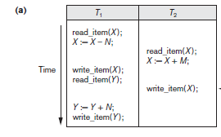
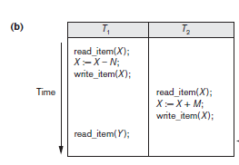
The schedule in Figure (a), which we shall call Sa, can be written as follows in this notation:
Sa: r1(X); r2(X); w1(X); r1(Y); w2(X); w1(Y);
Similarly, the schedule for Figure (b),which we call Sb, can be written as follows,
if we assume that transaction T1 aborted after its read_item(Y) operation:
Sb: r1(X); w1(X); r2(X); w2(X); r1(Y); a1;

Slide 4
Conflict Schedule
Two operations in a schedule are said to conflict if they satisfy all three of the following
conditions:
(1) they belong to different transactions;
(2) they access the same item X; and
(3) at least one of the operations is a write_item(X).

Slide 5
Conflict Schedules :
schedule Sa, the operations r1(X) and w2(X) conflict, as do the operations r2(X) and w1(X), and the operations w1(X) and w2(X).
However, the operations r1(X) and r2(X) do not conflict, since they are both read operations;
the operations w2(X) and w1(Y) do not conflict because they operate on distinct data items X and Y; and
the operations r1(X) and w1(X) do not conflict because they belong to the same transaction.

Slide 6
Intuitively, two operations are conflicting if changing their order can result in a different outcome.
For example, if we change the order of the two operations r1(X); w2(X) to w2(X); r1(X), then the value of X that is read by transaction T1 changes, because in the second order the value of X is changed by w2(X) before it is read by r1(X), whereas in the first order the value is read before it is changed. This is called a read-write conflict.
The other type is called a write-write conflict, and is illustrated by the case where we change the order of two operations such as w1(X); w2(X) to w2(X); w1(X).
For a write-write conflict, the last value of X will differ because in one case it is written by T2 and in the other case by T1.

Slide 7
Complete Schedule :
A schedule S of n transactions T1, T2, ..., Tn is said to be a complete schedule if the following conditions hold:
  1. The operations in S are exactly those operations in T1, T2, ..., Tn, including a commit or abort operation as the last operation for each transaction in the schedule.
  2. For any pair of operations from the same transaction Ti, their relative order of appearance in S is the same as their order of appearance in Ti.
  3. For any two conflicting operations, one of the two must occur before the other in the schedule.

Slide 8
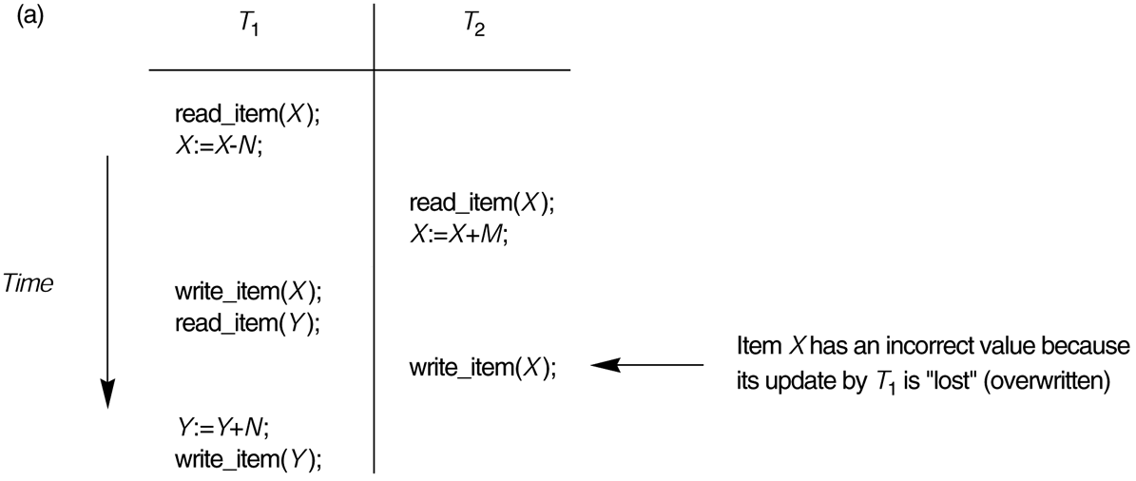
Characterizing Schedules Based on Recoverability
A transaction schedule describes the sequential ordering of the operations from each transaction, for example the schedule
rd1(X); X :=₁ X-N; rd2(X); X :=₂ X+M; wr1(X);rd1(Y); wr2(X); ...
corresponds with the following schema:

Slide 9
Schedules classified on recoverability:
Strict Schedule: A schedule in which a transaction can neither read or write an item X until the last transaction that wrote X has been committed.
Cascadeless schedule: Every transaction reads only the items that are written by committed transactions.
Schedules requiring cascaded rollback: A schedule in which uncommitted transactions that read an item from a failed transaction must be rolled back.
Recoverable schedule: No terminated transaction needs to be rolled back.
A schedule S is recoverable if no transaction T in S commits until all transactions T’ that have written an item that T reads have committed.

Slide 10
Characterizing Schedules based on Serializability
Serial schedule: A schedule S is serial if, for every transaction T participating in the schedule, all the operations of T are executed consecutively in the schedule.
Otherwise, the schedule is called non-serial schedule.
Serializable schedule: A schedule S is serializable if it is equivalent to some serial schedule of the same n transactions.

Slide 11
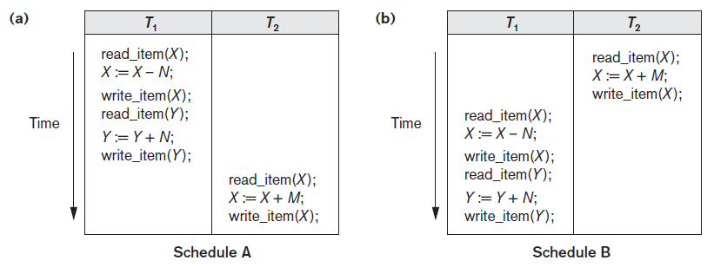
Serial schedule A: T1 followed by T2.
Serial schedule B: T2 followed by T1.
Figure 1

Slide 12
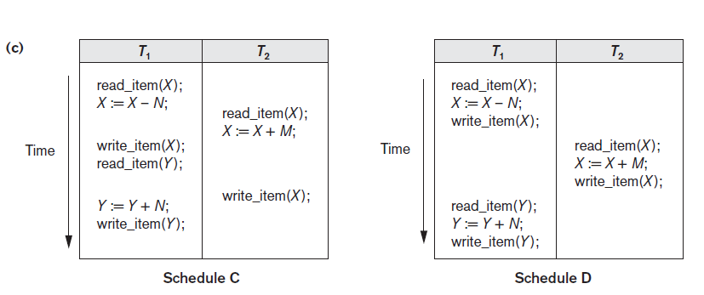
(c) Two non-serial schedules C and D with interleaving of operations
Figure 2

Slide 13
Result equivalent: Two schedules are called result equivalent if they produce the same final state of the database.
Conflict equivalent: Two schedules are said to be conflict equivalent if the order of any two conflicting operations is the same in both schedules.
Conflict serializable: A schedule S is said to be conflict serializable if it is conflict equivalent to some serial schedule S’.

Slide 14
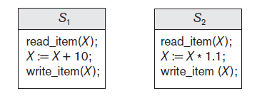
Example for Result Equivalent
Two schedules that are result equivalent for the initial value of X = 100 but are not result equivalent in general

Slide 15
Example for Conflict Equivalent
For example, if a read and write operation occur in the order r1(X), w2(X) in schedule S1, and in the reverse order w2(X), r1(X) in schedule S2, the value read by r1(X) can be different in the two schedules.
Similarly, if two write operations occur in the order w1(X), w2(X) in S1, and in the reverse order w2(X), w1(X) in S2, the next r(X) operation in the two schedules will read potentially different values;
or if these are the last operations writing item X in the schedules, the final value of item X in the database will be different.

Slide 16
Being serializable is not the same as being serial
Being serializable implies that the schedule is a correct schedule.
  It will leave the database in a consistent state.
  The interleaving is appropriate and will result in a state as if the transactions were serially executed, yet will achieve efficiency due to concurrent execution.

Slide 17
Serializability is hard to check.
  Interleaving of operations occurs in an operating system through some scheduler
  Difficult to determine beforehand how the operations in a schedule will be interleaved.

Slide 18
Algorithm to test for conflict serializability
1. For each transaction Ti participating in schedule S, create a node labeled Ti in the precedence graph.
2. For each case in S where Tj executes a read_item(X) after Ti executes a write_item(X), create an edge (Ti→ Tj) in the precedence graph.
3. For each case in S where Tj executes a write_item(X) after Ti executes a read_item(X), create an edge (Ti→Tj) in the precedence graph.
4. For each case in S where Tj executes a write_item(X) after Ti executes a write_item(X), create an edge (Ti→ Tj) in the precedence graph.
5. The schedule S is serializable if and only if the precedence graph has no cycles.

Slide 19
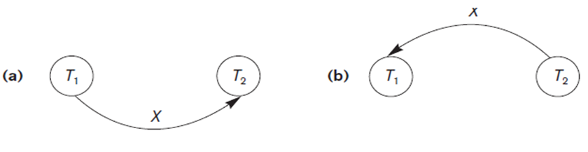
Constructing the precedence graphs for schedules A to B from Figure( 1& 2) to test for conflict serializability.
Precedence graph for serial schedule A.
Precedence graph for serial schedule B.

Slide 20
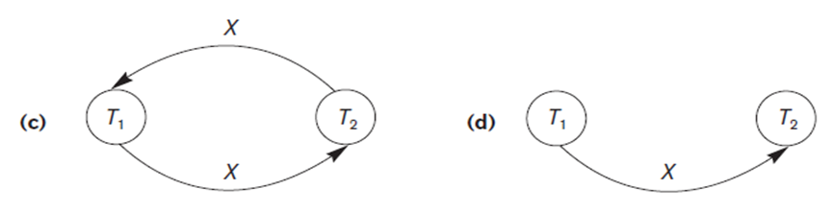
Constructing the precedence graphs for schedules C to D from Figure( 1& 2) to test for conflict serializability.
Precedence graph for schedule C (not serializable).
Precedence graph for schedule D (serializable, equivalent to schedule A).

Slide 21
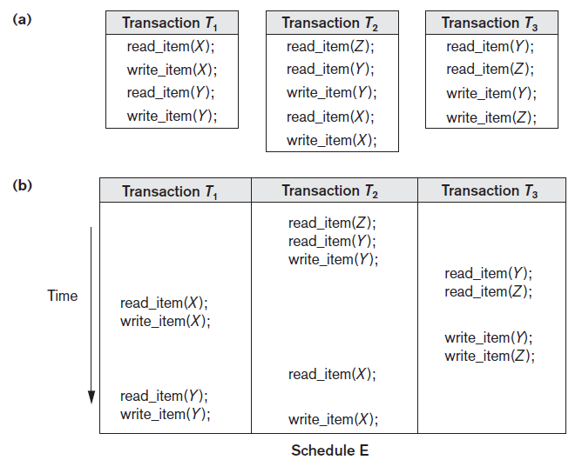
Another example of serializability testing
The read and write operations of three transactions T1, T2, and T3.
(b) Schedule E.

Slide 22
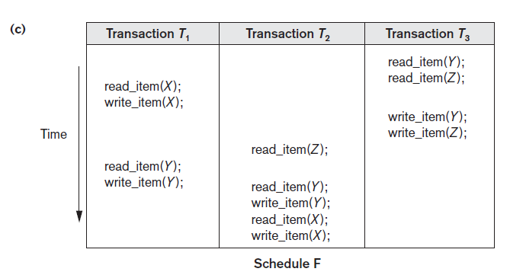
(c) Schedule F.

Slide 23
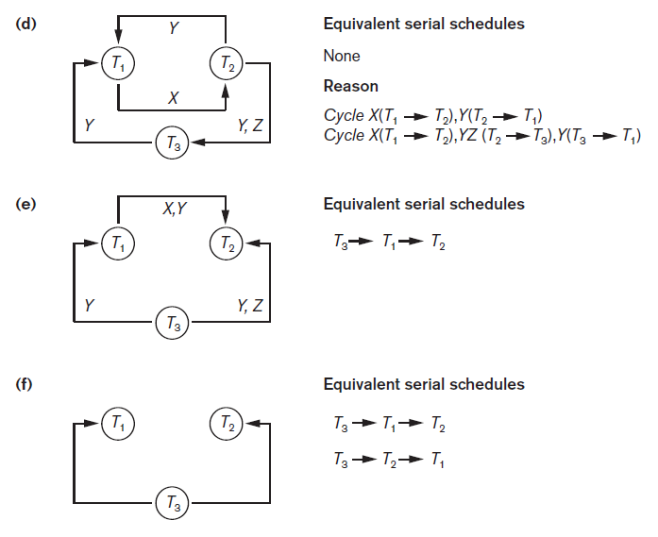
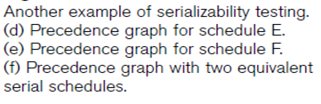

Slide 24
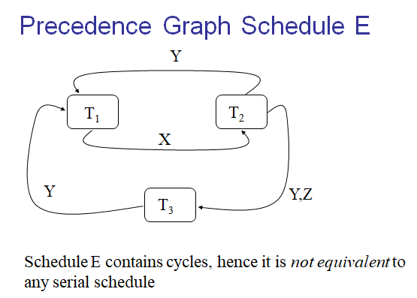

Slide 25
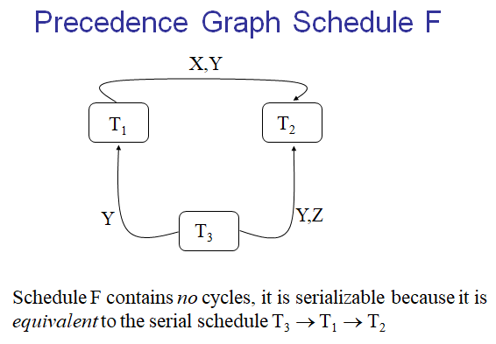

Slide 26
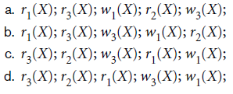
Exercise :
Which of the following schedule is (Conflict) serializable ? For each serializable schedule, determine the equivalent serial schedules

Slide 27
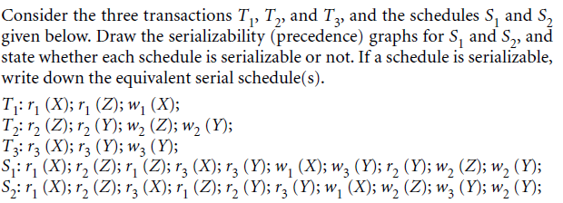
Exercise :

